Slide 1
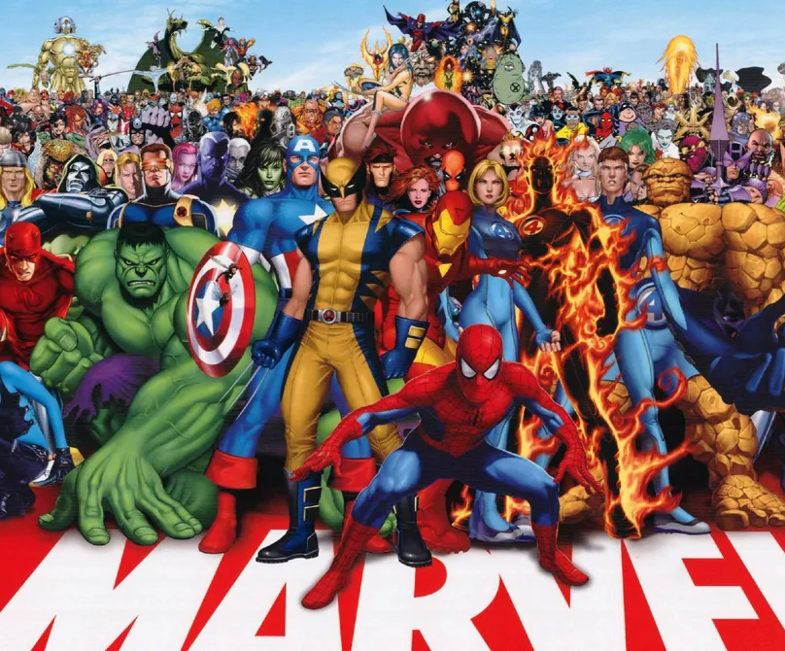
THE MARVEL
Present by:
Milind Randive(230971)
Anurag Gour()
Devansh ()
Course: B.tech(FSD)

Slide 2
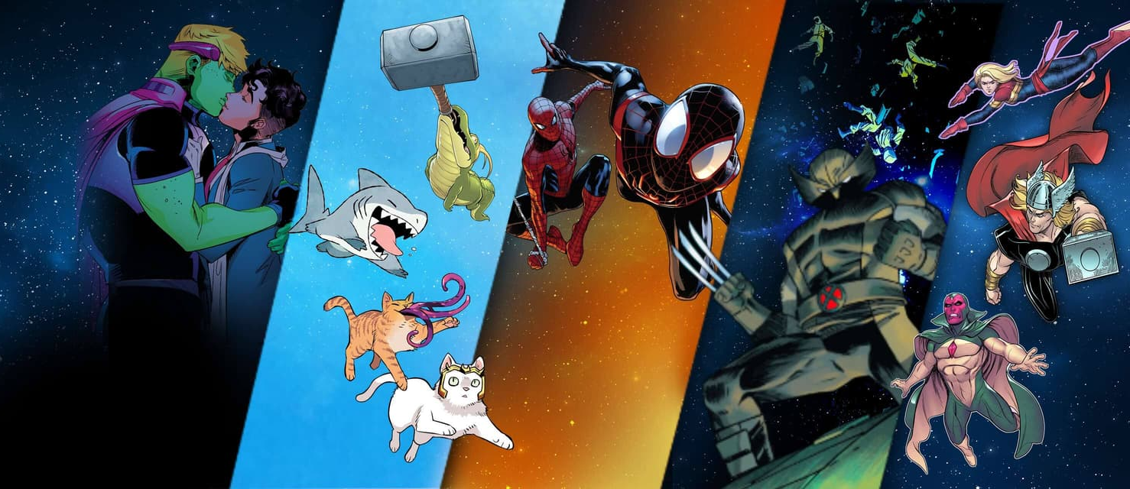
The Marvel Cinematic Universe
The Marvel Cinematic Universe (MCU) films are a series of American superhero films produced by Marvel Studios based on characters that appear in publications by Marvel Comics. The MCU is the shared universe in which all of the films are set. The films have been in production since 2007, and in that time Marvel Studios has produced and released 33 films, with at least 11 more in various stages of development.

Slide 3
Overview of the project
Project Goal: Design and develop a new, engaging website for Marvel Comics.
Target Audience:
Existing Marvel fans
Comic book enthusiasts
Potential new audience
Presentation Outline:
Briefly introduce myself marvel and its current web presence
Highlight the need for a website redesign
Website Objectives
Define the goals of the new website improved content organization, promoting fan intraction

Slide 4
Content Strategy
Outline the plan for creating and managing website content
Timeline and Budget:
Provide a high-level overview of the project timeline and budget.
Design Mockups:
Visually present the website’s layout, navigation, and visual style

Slide 5
Methodology used in making the website
Here are some methodology used to create the website:
* User-centered design (UCD): Involve target users throughout the design process to ensure the website meets their needs and expectations. Conduct user research to understand their goals, behaviors, and pain points.
* Agile development: Break down website development into smaller, iterative cycles. This allows for continuous feedback and improvement throughout the process.
* Content management system (CMS): Choose a CMS that allows for easy content creation and management. This will empower non-technical staff to update the website without relying on developers.
* Search engine optimization (SEO): Optimize the website for search engines to improve organic visibility. This includes using relevant keywords and meta descriptions.

Slide 6
Technology Stack
HTML and CSS are the fundamental technologies you'll need to create the website's structure and style. Here's a breakdown of their roles:
* HTML (Hypertext Markup Language) provides the website's structure by defining elements like headings, paragraphs, images, and navigation menus.
* CSS (Cascading Style Sheets) controls the website's visual appearance, including fonts, colors, layouts, and animations.
While HTML and CSS form the core, you can consider adding JavaScript for enhanced interactivity:
* JavaScript can add dynamic elements to your website, such as image carousels, interactive forms, or animations.

Slide 7
Design Decisions
Some key design decisions for a Marvel website:
* Target Audience: Identify the core audience segments (comic book fans, movie watchers, casual fans) to tailor content and user experience.
* Visual Design: Leverage the rich colors, action-packed scenes, and iconic characters from the Marvel universe to create a visually engaging website.
* Content Strategy: Offer a mix of content formats like character bios, movie trailers, comic snippets, and interactive features to cater to different interests.
* Navigation: Ensure a user-friendly and intuitive navigation system that allows visitors to easily find characters, movies, comics, and other relevant content.
* Responsiveness: Design a website that adapts seamlessly to different devices (desktops, tablets, smartphones) to provide an optimal viewing experience on any platform.

Slide 8
Challenges and Solution
The critical things to not forgot:
* Defining your website's goals and target audience: A clear understanding of what you want your website to achieve and who you're trying to reach is essential for creating an effective website.
* Technical expertise: Building a website from scratch requires knowledge of coding languages like HTML, CSS, and JavaScript. There are website builders that can help, but they also have limitations.
* Balancing design and functionality: Your website should be visually appealing and easy to navigate, but it should also be functional and meet the needs of your users.
* Creating a responsive website: With more and more people browsing the web on their smartphones and tablets, it's important to ensure your website looks good and functions well on all devices.
* Content creation: Websites need high-quality content to keep users engaged. This includes written content, images, and videos.
* Website security: Keeping your website secure is essential to protect your visitors' information and prevent malware attacks.
By being aware of these challenges and planning accordingly, you can increase your chances of building a successful website.

Slide 9
Conclusion and Future Scope
Conclusion
The Marvel website is a central hub for all things Marvel, offering fans a comprehensive look at the comics, movies, TV shows, characters, and more. It serves as a valuable resource for fans and a powerful marketing tool for the Marvel brand. The Marvel website doesn't have a definitive conclusion as it's an ongoing platform for fans of the Marvel Universe. It constantly updates with new information about comics, movies, TV shows, video games, and more.

Slide 10
Here's a glimpse into the future scope of the Marvel website:
* Enhanced Interactive Content: The website could incorporate more interactive features like quizzes, games, and AR experiences to engage fans and deepen their connection to the Marvel Universe.
* Personalized User Experience: By tailoring content and recommendations based on user preferences, the website can create a more personalized and immersive experience for each visitor.
* Integration with Streaming Services: The website could potentially integrate with Disney+ or other streaming services, allowing users to seamlessly access Marvel content directly from the website.
* E-commerce Integration: The website could offer an integrated e-commerce platform for fans to purchase merchandise, comics, and other Marvel products.

Slide 11
Future Work On The Project
Make it full responsive.
More use of fixed and grid .
Paying attention on the display property.
Adding of JavaScript for transection.
Use of simple and important or required terms.
Still more page remain to make it full.

Slide 12
THANK YOU

